Slide 1
Condensation & Temp.
Factors Influencing Their Rates

Slide 2
Outline
Temperature
Causes For Variation In…
Methods Of Achieving Saturation
Condensation
Definitions
How It Occurs
Condensation Nuclei
Causes Of Variation In E & C
Fog – 4 Main Types

Slide 3
Temperature
Several factors influence the temperatures of locations on the Earth.
Latitude
Altitude
Aspect (facing direction)
Ground cover (vegetation)
Substrate type (through albedo)
Air circulation & microclimate
Cloud cover
Pollution
Ocean current temperature
Proximity to ocean

Slide 4
Proximity To Ocean
Land and Sea have different properties.
These influence their capacity to retain heat…
Water has a HIGH SPECIFIC HEAT CAPACITY:
It requires more energy to heat a volume of water to the same temperature than that of an equal volume of land …

Slide 5
Proximity To Ocean
+1C
+1C
land
water
Add heat
Add MORE heat
The specific heat of water is about 5 times greater than that of land.
5 times more energy is required to heat water to the same temperature as an equal volume of land!

Slide 6
Proximity To Ocean
Other properties of water:
Water is transparent (land is opaque)
Water continually mixes (land is still)
Water evaporates (land has less efficient cooling)

Slide 9
Proximity To Ocean
All of this means that:
Water heats more slowly than land
Water cools more slowly than land
Land close to the ocean is influenced by the ocean (Moderating Effect):
It remains cooler in the summer and Milder in the winter Than land far from the ocean.

Slide 10
Proximity To Ocean
So we have 2 climate extremes:
MARITIME CLIMATES:
Close to the ocean
No extremes of temperature
Mild all year round.
CONTINENTAL CLIMATES:
Far from the ocean,
Great extremes of temperature
really hot summers,
really cold winters.
Any interior continent has this climate.

Slide 11
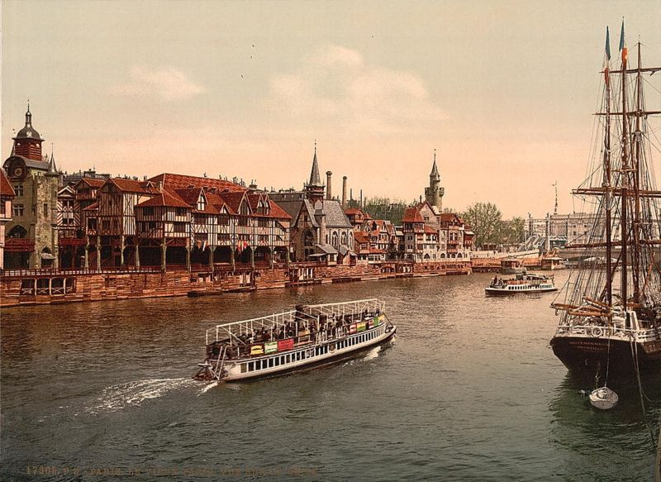
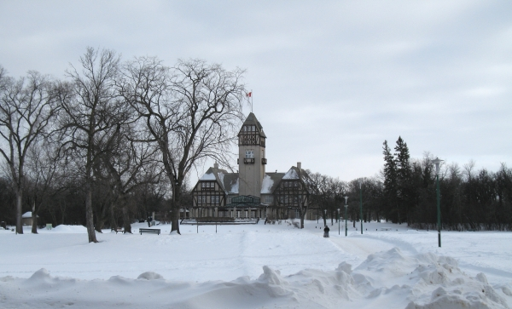
Paris, France Lat. 48° 52’N Temperatures range from 7 °C (45 °F) to 15 °C (59 °F)
Winnipeg, Canada Lat. 49° 54’ N Temperatures range from –35° C (-31° F) to 35° C (95° F)

Slide 12
Methods Of Achieving Saturation
3 General Processes:
Addition Of Water Vapor
As described in previous lecture
Examples of which are also to follow
Lowering Temperature To The Dew Point
Most common means of cloud/fog formation
Examples to follow today and also subject of next lecture
Mixing Of Cold Air With Warm, Moist Air
Examples of which are to follow
Regardless Of Method, Recall That Saturation Point Is Achieved Once
Vapor Pressure in Air is in Equilibrium with Liquid
IE. Vapor Pressure in Air = Saturation/Equilibrium Pressure

Slide 13
Condensation
Process By Which Water Vapor Becomes A Liquid.
“NET” Condensation Occurs When Air Vapor Pressure > Saturation Vapor Pressure
Condensation Warms the Air
Remember that during Evaporation energy is removed from a surface and stored as latent heat in the vapor
Thus, condensation releases the stored energy from the vapor causing the surrounding air to warm
This is critical to the development of Hurricanes!

Slide 14
Condensation Surfaces
How Does It Occur?
Condensation generally occurs upon a surface of some sort.
These surfaces are readily available in nature
The absence of such surfaces, in any given situation, is very rare.
On these rare occasions, we find that air must be SUPERSATURATED prior to the occurrence of condensation (see discussion to follow)
Examples Of Condensation Surfaces:
Stems of grass and leaves in cool morning air
RH increases to 100% as Air Temperature Falls To The Dew Point.

Slide 15
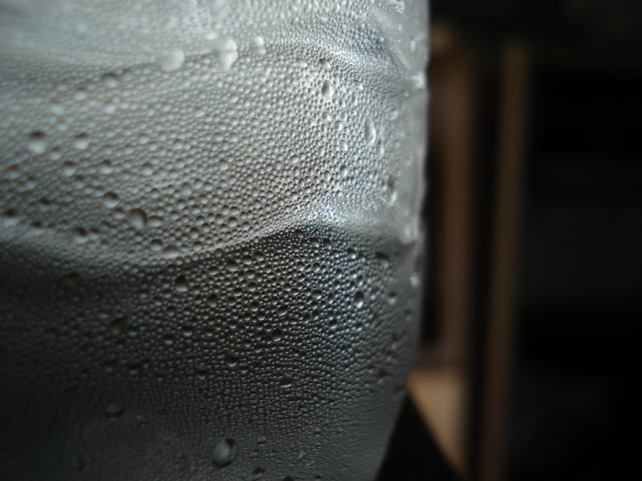
Cold Water Bottle Cools Adjacent Air To The Dew Point Temperature & the Point Of Saturation.
Leads To Condensation

Slide 16
Condensation Surfaces
Examples (Cont.):
Cool Bathroom Tile/Mirror During A Hot Shower
Warm water evaporates, thereby Adding Water Vapor To The Air and bringing it to the point of saturation
Saturation, and resultant Condensation, occurs, first, on the cold mirror and tile
Thin laminar layer of air adjacent to surface is cooled through Conduction until saturation is reached (RH = 100%)

Slide 17
Condensation Surfaces
Examples:
Cool Bathroom Tile/Mirror During A Hot Shower (cont.)
If Evaporation is permitted to continue the whole bathroom will ‘steam up’.
But this is really fog, not steam.
‘Steam Fog’ is also seen in nature

Slide 18
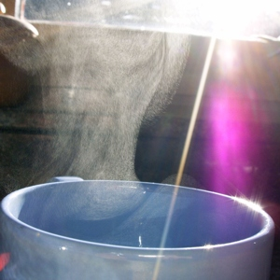
Hot Tea Adds Water Vapor To The Air Through Evaporation.
Vapor Condenses In Cooler Air Above The Mug As ‘Steam’.

Slide 19
Variations In Saturation
On average, condensation occurs when RH = 100%.
However, this varies depending upon
The type of Condensation Surface, and
The purity of water

Slide 20
Variations In Saturation
Atmospheric Condensation Surfaces
Condensation Nuclei
e.g. particulate matter such as
Soot,
Pollen,
Sea salt,
Dust,
Ash, etc.
They are plentiful, but are available in highest concentrations in urban areas.

Slide 21
“Smoky Fog” (Smog) Behind The Golden Gate Bridge

Slide 22
Variations In Saturation
Some Condensation Nuclei attract water to themselves
These are called: HYGROSCOPIC NUCLEI
Because they attract water, they produce LARGER droplets.
Other Condensation Nuclei repel water
These are called: HYDROPHOBIC NUCLEI
Because they repel water, they produce SMALLER droplets.

Slide 23
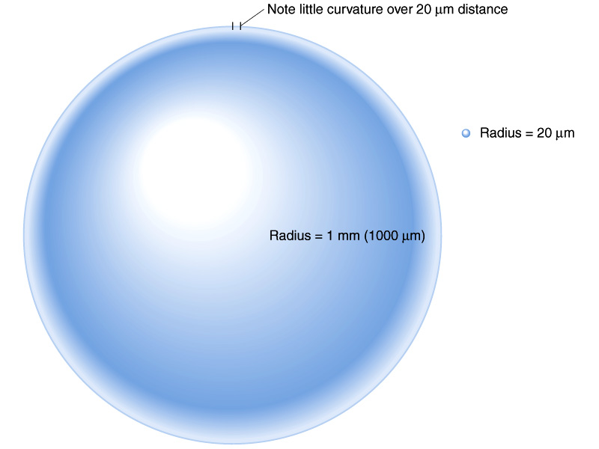

Slide 24
Curvature Effect On Saturation
Curved Surface Has More Energy than Flat Surface due to Tension
Think of a floor board, The more you bend it the more tension or stress it undergoes
Increasing Tension increases Energy of Liquid Molecules increasing their Ability to Evaporate (Same way Temperature Does)
This means the vapor pressure at Equilibrium or Saturation increases over curved surface

Slide 25
Supersaturation
Water Droplet Size
When water droplets are very tiny, the curvature of their surface is very high:
Saturation Vapor Pressure over surface with high curvature is much higher than that over flat surface
This means Vapor Pressure of air must be MUCH higher in order to produce condensation over a curved surface
Since RH is calculated from Saturation over Flat surface, RH must be GREATER than 100%!
RH > 100% Known as SUPERSATURATION
Remember Air can hold more vapor than Saturation Value

Slide 26
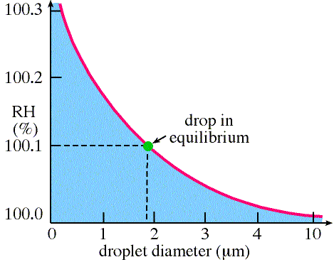
Curvature Effect

Slide 27
Why Cloud Nuclei?
Small Drop Sizes Require Incredibly Large RH
These levels of supersaturation do not eist in nature
In fact, it would require an infinite supersaturation to create drop in first place
So How are Cloud Drops created in the first place? CLOUD CONDENSATION NUCLEI

Slide 28
Solutes Effect on Saturation
Water Purity
In PURE water,
Evaporation occurs more rapidly than in water containing
DISSOVLED SOLUTES (Salt Water)
This is because the solutes occupy a portion of the surface area of a droplet that would have otherwise been occupied by water molecules
This reduces the ability of water molecule to escape surface reducing the Equilibrium or Saturation Vapor Pressure Over Surface

Slide 29
Solutes Effect on Saturation
The Solute Effect of Reducing Saturation Offsets Curvature Effect
For small drops solute effect stronger
For bigger drop solute is more diluted and has less effect
The result is pressure over surface is maximum for medium size drops
If vapor pressure in air exceeds this maximum then drops are free to grow, Otherwise drop size limited.
BUT small drops can exist at RH<100%

Slide 30
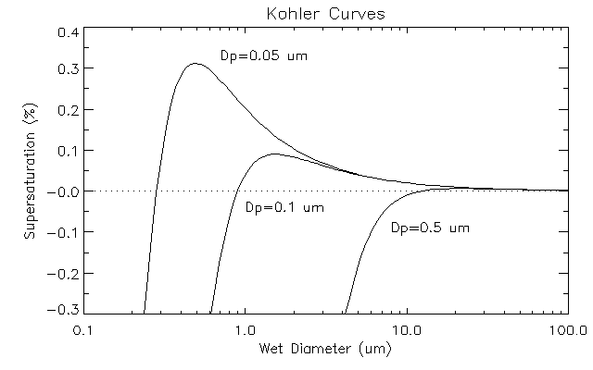
Combined Solute/Curvature Effect

Slide 31
Fog
A visible aggregate of tiny water droplets (basically, a cloud) occurring at the ‘surface’ – touching the ground
Thin fogs are called ‘Mist’
4 primary types of fog
Radiation (Ground) Fog
Advection Fog
Evaporation/Steam Fog
Upslope Fog

Slide 32
Radiation (Ground) Fog
Caused by the loss of longwave radiation during the night
Therefore is more prevalent on nights that
are cloudless (radiation can’t be trapped),
follow warm days (warmer ground = more radiation),
are long (Winter/Fall)
Requires a high Relative Humidity
Low Temperature (Night, Early Morning)
Moist Air (Post Rain Event)

Slide 33
Radiation (Ground) Fog
Rapidly cooling ground creates a TEMPERATURE INVERSION
Cools a laminar layer of air adjacent to it, through conduction, to the point of saturation.
Thus this layer is COLDER than the air above it!
Air is supposed to cool with rising elevation
This laminar layer is then gently mixed with the air above it by a light wind (forced convection)
This extends the INVERSION
All air beneath this point is saturated!

Slide 35
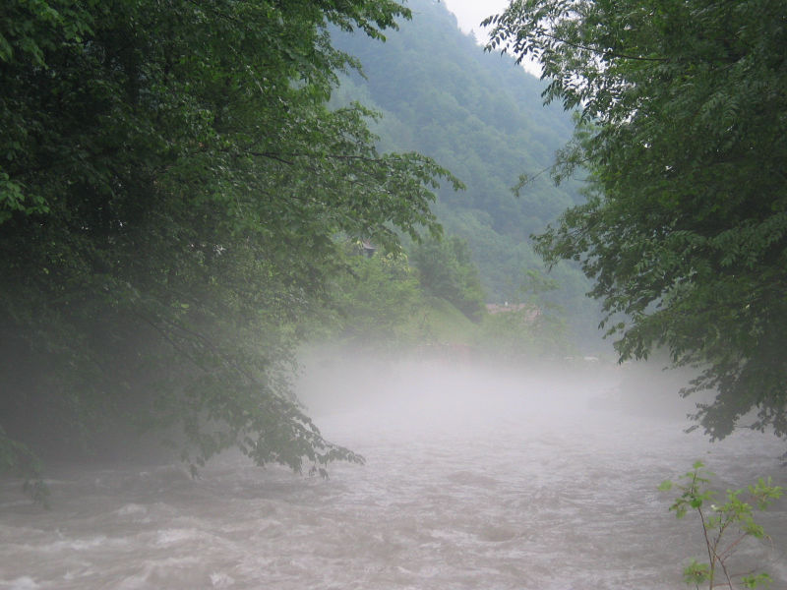

Slide 36
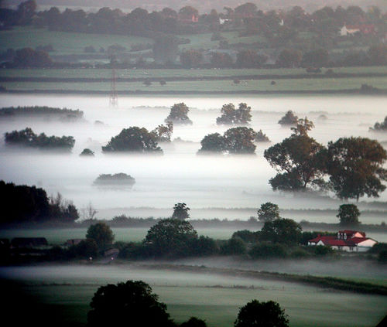

Slide 37
Valley Fog
Derivation of Radiation Fog confined by local topography
Thin air at higher elevations cools faster
Cool Air is more dense than warm air
Thus when this occurs in the vicinity of depressions, like valleys, this cool air will sink and collect there
This forces the warmer air in the depression to rise
Creating a TEMPERATURE INVERSION
All air beneath this point is saturated!

Slide 38
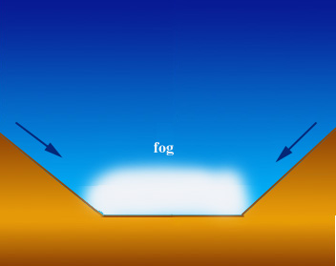

Slide 39
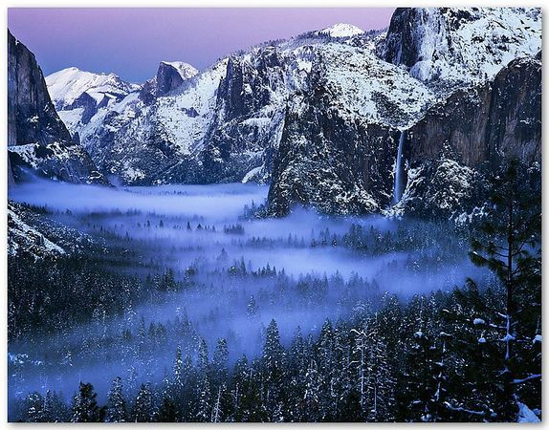

Slide 40
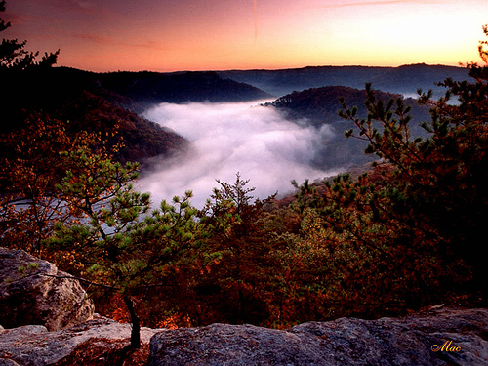

Slide 41
Advection Fog
Occurs when warm, moist air moves HORIZONTALLY over a cold surface.
Air is cooled by the surface to the point of saturation
Warm front passing over snowpack
Warm air above warm ocean is blown ashore where land is colder, or ocean is colder (San Francisco, California Current comes down from North so Ocean is very COLD)

Slide 42
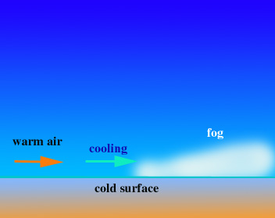

Slide 44
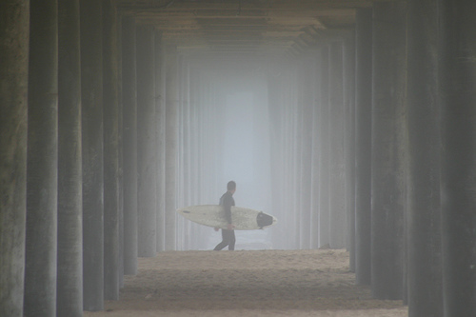

Slide 45
Evaporation/Steam Fog
Created by cold air passing over much warmer, moister water or land
The warm and wet surface evaporates vapor into the cold air where it becomes saturated and condenses.
Examples:
Outdoor heated pools in winter,
Lakes in fall,
Warm ocean current in cold latitude,
Cup of tea
Your breath on a cold day!

Slide 46
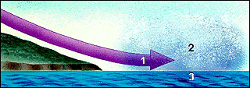

Slide 47
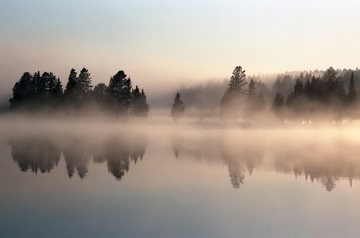

Slide 49
Upslope Fog
Air moving up a gently sloping surface expands and cools as it moves up
Common on west slope of Great Plains, as air moves up foothills of the Rockies

Slide 50
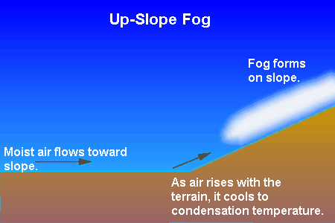

Slide 51
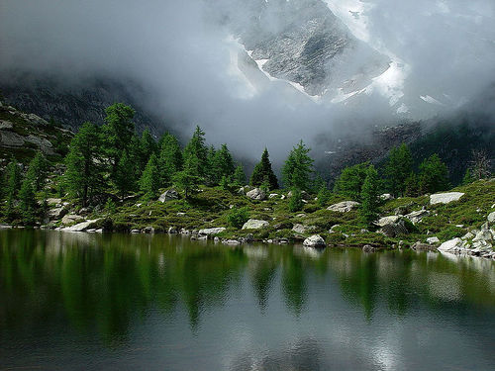

Slide 52
